Slide 1
Data Mining: Concepts and Techniques (3rd ed.) — Chapter 8 —
Jiawei Han, Micheline Kamber, and Jian Pei
University of Illinois at Urbana-Champaign &
Simon Fraser University
©2011 Han, Kamber & Pei. All rights reserved.
1
Notes:
1

Slide 2
Chapter 8. Classification: Basic Concepts
Classification: Basic Concepts
Decision Tree Induction
Bayes Classification Methods
Rule-Based Classification
Model Evaluation and Selection
2
Notes:
2

Slide 3
Prediction Problems: Classification vs. Regression
Classification (Model for categorical data)
predicts categorical class labels (discrete or nominal)
classifies data (constructs a model) based on the training set and the values (class labels) in a classifying attribute and uses it in classifying new data
Regression (Numeric Prediction)
models continuous-valued functions, i.e., predicts unknown or missing values
Typical applications
Credit/loan approval:
Medical diagnosis: if a tumor is cancerous or benign (Bay-nine)
Fraud detection: if a transaction is fraudulent
Web page categorization: which category it is

Slide 4
Classification—A Two-Step Process (Learning, classification)
Model construction: describing a set of predetermined classes
Each tuple/sample is assumed to belong to a predefined class, as determined by the class label attribute
The set of tuples used for model construction is training set
The model is represented as classification rules, decision trees, or mathematical formulae
Model usage: for classifying future or unknown objects
Estimate accuracy of the model
The known label of test sample is compared with the classified result from the model
Accuracy rate is the percentage of test set samples that are correctly classified by the model (i.e classifier)
Test set is independent of training set (otherwise overfitting)
If the accuracy is acceptable, use the model to classify new data (or future data)
Such Future data of without label is also called UNKNOWN or UNSEEN DATA in machine learning.
Note: If the test set is used to select models, it is called validation (test) set

Slide 5
Process (1): Model Construction
Training Data → Test Data → Unseen data
Classification
Algorithms
Training
Data
Classifier
(Model)
IF rank = ‘professor’
OR years > 6
THEN tenured = ‘yes’

Slide 6
Process (2): Using the Model in Prediction
Classifier
Testing
Data
Unseen Data
(Jeff, Professor, 4)
Tenured?
Notes:
Training Data → Test Data → Unseen data

Slide 7
Supervised vs. Unsupervised Learning
Supervised learning (classification)
Supervision: The training data (observations, measurements, etc.) are accompanied by labels indicating the class of the observations
New data is classified based on the training set
Unsupervised learning (clustering)
The class labels of training data is unknown
Given a set of measurements, observations, etc. with the aim of establishing the existence of classes or clusters in the data

Slide 8
Chapter 8. Classification: Basic Concepts
Classification: Basic Concepts
Decision Tree Induction
Bayes Classification Methods
Rule-Based Classification
Model Evaluation and Selection
8
Notes:
8

Slide 9
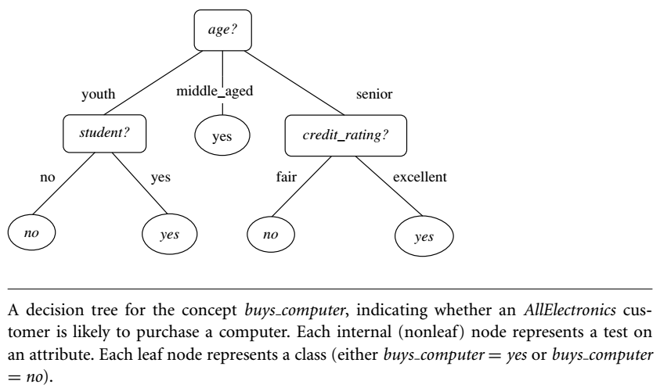
Decision tree induction
It is the learning of decision trees from class-labeled training tuples.
A decision tree is a flowchart-like tree structure, where each internal node (nonleaf node) denotes a test on an attribute, each branch represents an outcome of the test, and each leaf node (or terminal node) holds a class label.
The topmost node in a tree is the root node.

Slide 10
Decision Tree Induction: An Example
Training data set: Buys_computer
The data set follows an example of Quinlan’s ID3 (Playing Tennis)
Resulting tree:
age?
<=30
overcast
>40
31..40
student?
yes
credit rating?
no
yes
excellent
fair
no
yes
no
yes
Notes:
In decision tree learning, ID3 (Iterative Dichotomiser 3) is an algorithm invented by Ross Quinlan used to generate a decision tree from a dataset.

Slide 11
Decision tree induction
During 1970-1980 J.Ross Quinlan a researcher of machine learning
Developed a decision tree algorithm
ID3 (Iterative Dichotomiser)
C4.5 (a successor of ID3)
It was benchmarks for testing other new supervised learning algos.
A group of statisticians published a book
Classification and Regression Trees (CART): it describes the binary tree
ID3, C4.5, and CART adopt a greedy (i.e., nonbacktracking) approach in which decision trees are constructed in a top-down recursive divide-and-conquer manner.
Notes:
A greedy algorithm, as the name suggests, always makes the choice that seems to be the best at that moment.
This means that it makes a locally ­optimal choice in the hope that this choice will lead to a globally­ optimal solution.
Some common programming techniques
1. Divide and conquer 2. Randomized algorithms 3. Greedy algorithms (This is not an algorithm, it is a technique.) 4. Dynamic programming

Slide 12
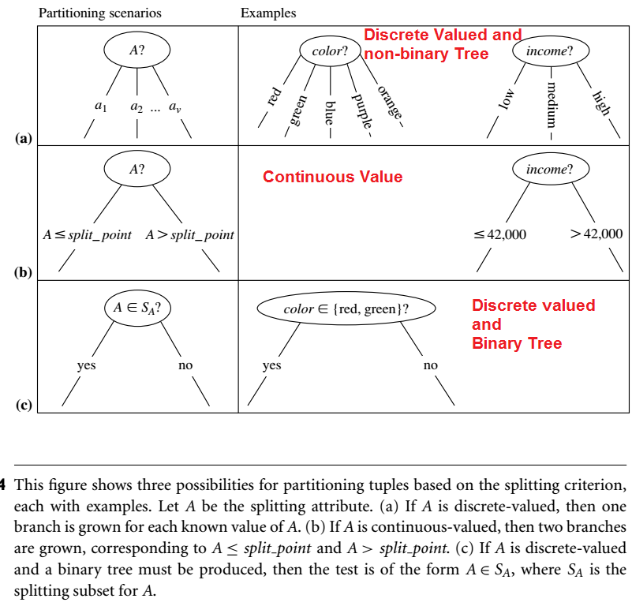

Slide 13
Decision Tree Algorithm
Algorithm has three parameters
D, attribute list, and Attribute selection method.
D: is a data partition. Initially, it is the complete set of training tuples and their associated class labels.
Attribute List: is a list of attributes describing the tuples.
Attribute selection method specifies a heuristic procedure for selecting the attribute that “best” discriminates the given tuples according to class. Methods are:
Information Gain (Two or many branches of node in tree)
Gini Index (Binary tree)

Slide 14
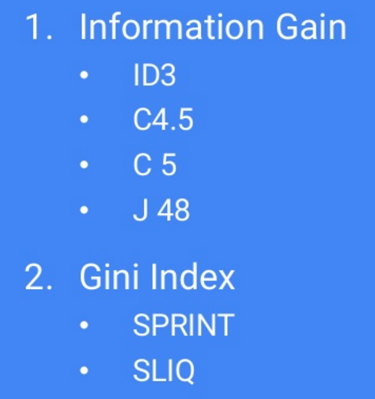
Classification Methods

Slide 15
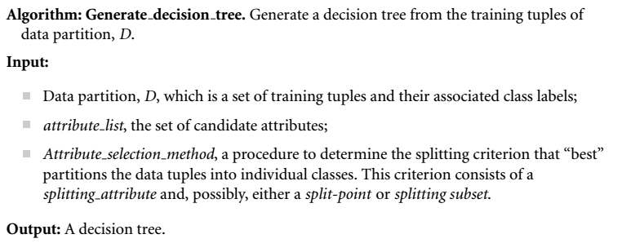
Decision Tree Algorithm…

Slide 16
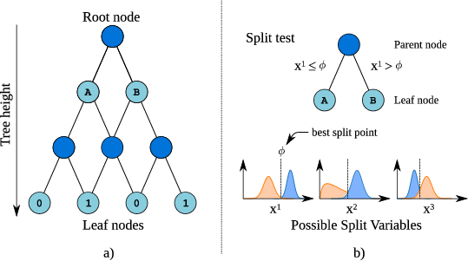
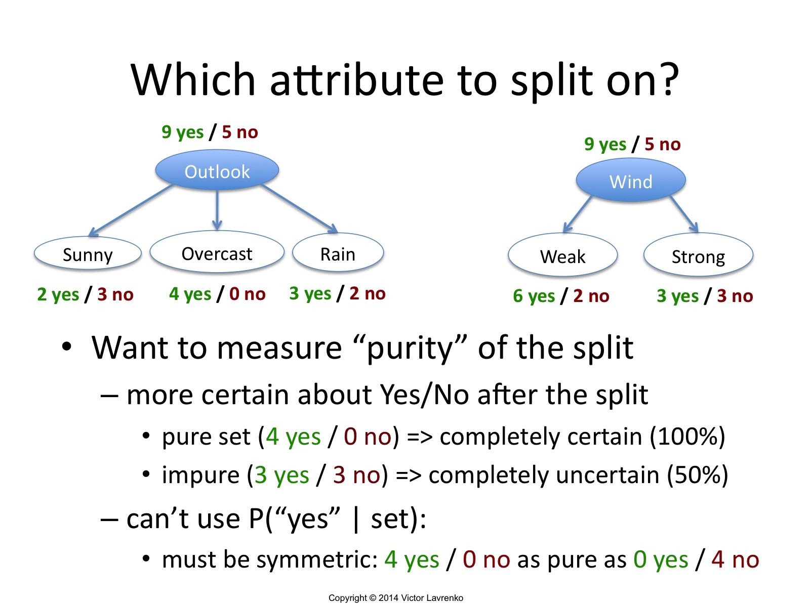
Decision Tree Algorithm…
Node split criterion: tells us which branches to grow from node N with respect to the outcomes of the chosen test.
It may also indicate either a split-point or a splitting subset.
It also determine the resulting partitions at each branch are as “pure” as possible.
A partition is pure if all the tuples in it belong to the same class. Like EMPID result in a large no of partitions.

Slide 17
Algorithm for Decision Tree Induction
Basic algorithm (a greedy algorithm)
Tree is constructed in a top-down recursive divide-and-conquer manner
At start, all the training examples are at the root
Attributes are categorical (if continuous-valued, they are discretized in advance)
Examples are partitioned recursively based on selected attributes
Test attributes are selected on the basis of a heuristic or statistical measure (e.g., information gain)
Conditions for stopping partitioning
All samples for a given node belong to the same class
There are no remaining attributes for further partitioning – majority voting is employed for classifying the leaf
There are no samples left

Slide 18
Attribute selection measures or Splitting rules
The attribute having the best score for the measure is chosen as the splitting attribute for the given tuples.
If the splitting attribute is continuous-valued determine a split point split criterion or
if we are restricted to binary trees, use splitting subset as split criterion.
three popular attribute selection measures—
information gain,
gain ratio, and
Gini index

Slide 19
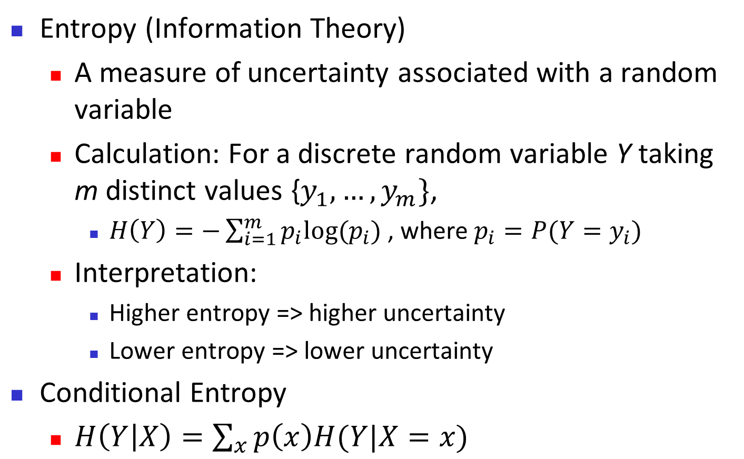
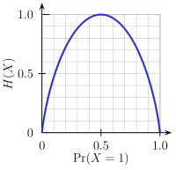
Brief Review of Entropy
m = 2

Slide 20
Attribute Selection Measure: Information Gain (ID3/C4.5)
Select the attribute with the highest information gain
Let p_{i} be the probability that an arbitrary tuple in D belongs to class C_{i}, estimated by |C_{i, D}|/|D|
Expected information (entropy) needed to classify a tuple in D:
Information needed (after using A to split D into v partitions) to classify D:
Information gained by branching on attribute A
Notes:
I : the expected information needed to classify a given sample
E (entropy) : expected information based on the partitioning into subsets by A

Slide 21


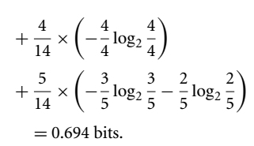
Attribute Selection: Information Gain
Class P: buys_computer = “yes”
Class N: buys_computer = “no”
means “age <=30” has 5 out of 14 samples, with 2 yes’es and 3 no’s. Hence
Similarly,

Slide 22
Age attribute is Discretized
RID | age | income | student | credit_rating | buys_computer
1 | <=30 | high | no | fair | no
2 | <=30 | high | no | excellent | no
3 | 31…40 | high | no | fair | yes
4 | >40 | medium | no | fair | yes
5 | >40 | low | yes | fair | yes
6 | >40 | low | yes | excellent | no
7 | 31…40 | low | yes | excellent | yes
8 | <=30 | medium | no | fair | no
9 | <=30 | low | yes | fair | yes
10 | >40 | medium | yes | fair | yes
11 | <=30 | medium | yes | excellent | yes
12 | 31…40 | medium | no | excellent | yes
13 | 31…40 | high | yes | fair | yes
14 | >40 | medium | no | excellent | no
RID | age | income | student | credit_rating | buys_computer
1 | Youth | high | no | fair | no
2 | Youth | high | no | excellent | no
3 | Middle-Age | high | no | fair | yes
4 | Senior | medium | no | fair | yes
5 | Senior | low | yes | fair | yes
6 | Senior | low | yes | excellent | no
7 | Middle-Age | low | yes | excellent | yes
8 | Youth | medium | no | fair | no
9 | Youth | low | yes | fair | yes
10 | Senior | medium | yes | fair | yes
11 | Youth | medium | yes | excellent | yes
12 | Middle-Age | medium | no | excellent | yes
13 | Middle-Age | high | yes | fair | yes
14 | Senior | medium | no | excellent | no
Age is discretized

Slide 23
Split_point
How to compute information gain for continuous valued (instead of age discretization as in last example)
The determine split point
Sort the values of A in ascending order
Mid point of two adjacent values is split-point
A= (a_{i}+a_{i+1})/2
D₁ set of tuples in D satisfying A<= split_point
D₂ set of tuples in D satisfying A> split_point

Slide 24
Computing Information-Gain for Continuous-Valued Attributes
Let attribute A be a continuous-valued attribute
Must determine the best split point for A
Sort the value A in increasing order
Typically, the midpoint between each pair of adjacent values is considered as a possible split point
(a_{i}+a_{i+1})/2 is the midpoint between the values of a_{i} and a_{i+1}
The point with the minimum expected information requirement for A is selected as the split-point for A
Split:
D1 is the set of tuples in D satisfying A ≤ split-point, and D2 is the set of tuples in D satisfying A > split-point

Slide 25
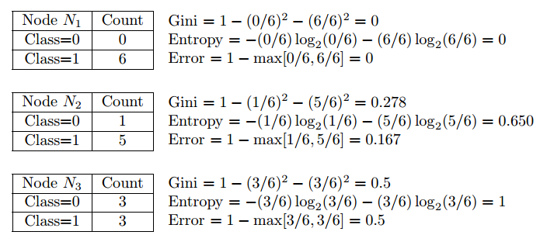
Information gain is biased
The information gain measure is biased toward tests with many outcomes.
That is, it prefers to select attributes having a large number of values.
Consider the formula:
If info_{A}(D) is zero (like for EMPID it has all unique values so it is zero.)
Then Gain will be max, it become useless in this case
So Gain is biased when large number of discrete values.

Slide 26

Gain Ratio for Attribute Selection (C4.5)
C4.5 (a successor of ID3) uses gain ratio to overcome the problem (normalization to information gain)
Ex.
gain_ratio(income) = 0.029/1.557 = 0.019
The attribute with the maximum gain ratio is selected as the splitting attribute

Slide 27


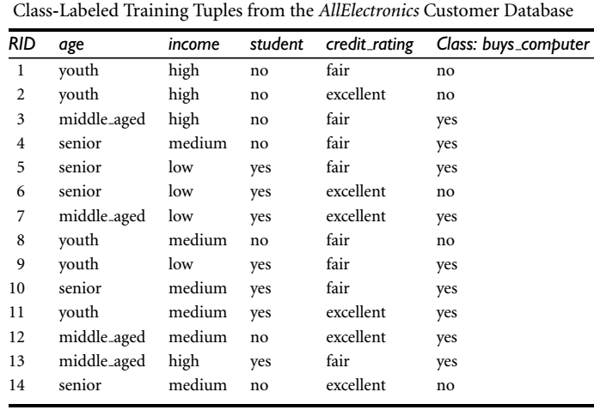
Gain ratio for income:
Income Splits into three patition
i.e low, medium, high
Contains 4,6,4 tuples
SplitInfo_{income}(D) = -(-4/14 * log₂(4/14) -6/14* log₂(6/14)-4/14 * log₂(4/14)) = 1.557
Gain(Income) = 0.029
GainRatio(income)= 0.029/1.557 = 0.019
Gain ratio for Age
Age splits into Three partitions i.e youth, middle_age, senior
Contains 5,4,5 tuples
SplitInfo_{age}(D) = -( -5/14 * log₂(5/14) -4/14 * log₂(4/14) -5/14 * log₂(5/14) )= 1.577
Gain(age) = 0.246
GainRatio(Age) = 0.246/1.577 = 0.156

Slide 28
Gain Ratio…
Find the information gain for student and credit_rating
The attribute with the maximum gain ratio is selected as the splitting attribute.
Note, however, that as the split information approaches 0, the ratio becomes unstable.
A constraint is added to avoid this, whereby the information gain of the test selected must be large (at least as great as the average gain over all tests examined. )

Slide 29
Gini Index (CART, IBM IntelligentMiner)
Used Classification And Regression Trees (CART)
It measure the impurity of
A dataset D,
a data partition or
set of training tuples.
If a dataset D contains examples from n classes, gini index, gini(D) is defined as
where p_{j} is the relative frequency of class j in D
Its overall Dataset’s heterogeneity/impurity/diversity.
Notes:
Gini index calculates diversity or heterogeneity (or uncertainty if you will) from the sum of squared category probabilities.
If every value is in the same category, then the measure is 1−1^2=0.
If every value of n values is in a distinct category, then the measure is 1−n(1/n)^2=1−1/n.

Slide 30
Gini Index (CART, IBM IntelligentMiner)
If a dataset D is split on A into two subsets D₁ and D₂, the gini index gini(D) is defined as
Reduction in Impurity:
The attribute that has the minimum Gini index is selected as the splitting attribute. OR
The attribute that maximizes the reduction in impurity.
(need to enumerate all the possible splitting points for each attribute)

Slide 31
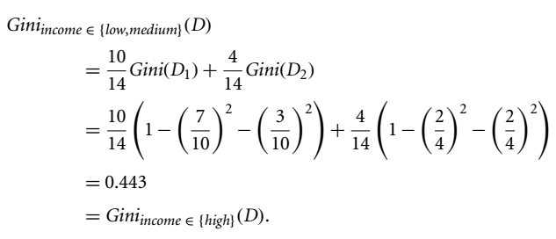
Computation of Gini Index (EXAMPLE)
Ex. D has 9 tuples in buys_computer = “yes” and 5 in “no”
We need to compute the Gini index for each attribute.
INCOME Possible subsets are {low, medium, high} are 2^3=8
i.e {} {low, medium, high} are not actually represent binary split so 2^3-2=6
i.e {low, medium}, {low, high}, {medium, high}, {low}, {medium}, {high}
Consider subset {low, medium} have 10 tuples Say D₁
Out of 10 tuples 7 tuples are of YES 3 are of No
The remaining {high} have 4 tuples say D₂
Out of 4 tuples 2 tuples are of YES 2 are of No
Similarly other subset are calculated
Gini_{income} ∈ {low,high} (D)= 0.458
Gini_{income} ∈ {medium,high} (D)= 0.450

Slide 32
Gini_{income} ∈ {low,Medium} (D)= 0.443
Gini_{income} ∈ {low,high} (D)= 0.458
Gini_{income} ∈ {medium,high} (D)= 0.450
The best binary split for attribute income is on {low, medium} (or {high}) because it minimizes the Gini index.
Similarly
Gini_{Age} ∈ {youth,senior} (D) = 0.375 (Min. Gini index Overall index)
Gini_{Student} (D) = 0.367
Gini_{Credit_Rating} (D) = 0.429
Age provides overall minimum Gini index so selected as split node N₁
Δgini(Age) = 0.459 – 0.357 = 0.102 (1)
Δgini(income) = 0.459 – 0.443 = 0.016 (4)
Δgini(Student) = 0.459 – 0.367 = 0.092 (2)
Δgini(Credit_Rating) = 0.459 – 0.429 = 0.03 (3)

Slide 33
Lec #2

Slide 34
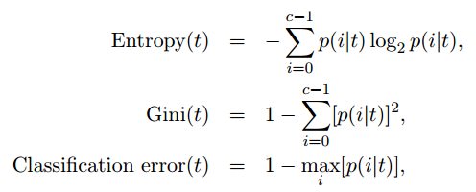
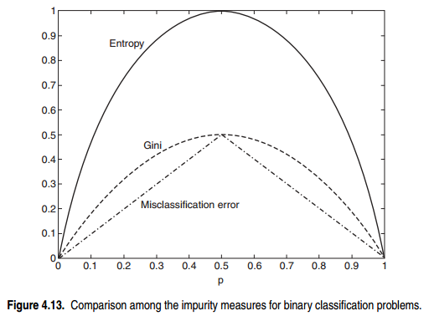
Comparison
Node 1 has lowest impurity, followed by node 2 and node3.
Notes:
Gini index measure impurity(How much difficult to decide from 0 to 0.5)
Gini = 0 means highly pure(easy to classify) on Class(0/6)
Gini = 0.5 means highly impure (difficult to classify) class(3/3)

Slide 35
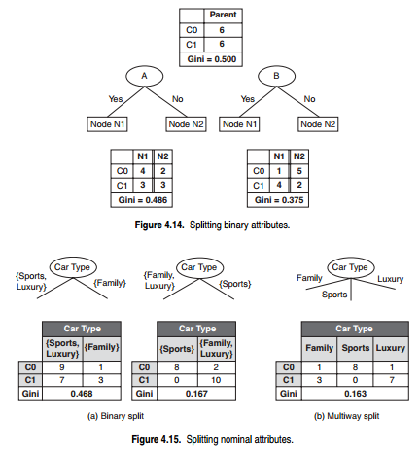

Slide 36
Comparing Attribute Selection Measures
The three measures, in general, return good results but
Information gain:
biased towards multivalued attributes
Gain ratio:
tends to prefer unbalanced splits in which one partition is much smaller than the others (no of tuples of D1={low,medium} > D2={High})
Gini index:
biased to multivalued attributes
has difficulty when # of classes is large
tends to favor tests that result in equal-sized partitions and purity in both partitions

Slide 37
Other Attribute Selection Measures
CHAID: a popular decision tree algorithm, measure based on χ² test for independence
C-SEP: performs better than info. gain and gini index in certain cases
G-statistic: has a close approximation to χ² distribution
MDL (Minimal Description Length) principle (i.e., the simplest solution is preferred):
The best tree as the one that requires the fewest # of bits to both (1) encode the tree, and (2) encode the exceptions to the tree
Multivariate splits (partition based on multiple variable combinations)
CART: finds multivariate splits based on a linear comb. of attrs.
Which attribute selection measure is the best?
Most give good results, none is significantly superior than others

Slide 38
Which attribute selection measure is the best?”
All measures have some bias.
It has been shown that the time complexity of decision tree induction generally increases exponentially with tree height.
Hence, measures that tend to produce shallower trees (e.g., with multiway rather than binary splits, and that favor more balanced splits) may be preferred.
However, some studies have found that shallow trees tend to have a large number of leaves and higher error rates.
Despite several comparative studies, no one attribute selection measure has been found to be significantly superior to others.
Most measures give quite good results.

Slide 39
Overfitting and Tree Pruning
Overfitting: An induced tree may overfit the training data
Too many branches, some may reflect anomalies due to noise or outliers
Poor accuracy for unseen samples
Two approaches to avoid overfitting
Prepruning: Halt tree construction early ̵ do not split a node if this would result in the goodness(InfoGain,GainRatio or Gini) measure falling below a threshold
Difficult to choose an appropriate threshold
Postpruning: Remove branches from a “fully grown” tree—get a sequence of progressively pruned trees
Use a set of data different from the training data to decide which is the “best pruned tree”

Slide 40
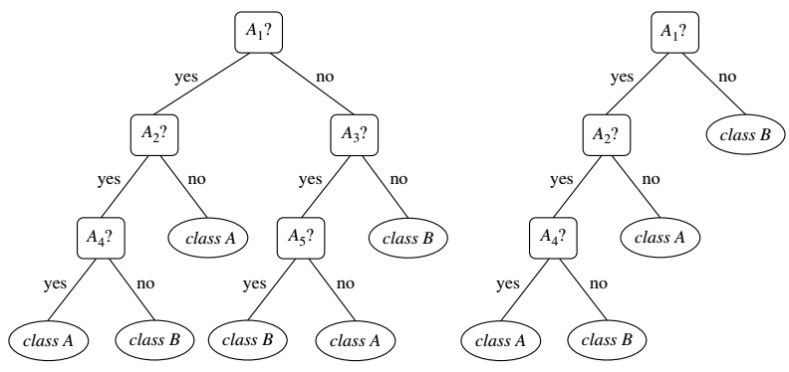
An unpruned decision tree and a pruned version of it

Slide 41
Enhancements to Basic Decision Tree Induction
Allow for continuous-valued attributes
Dynamically define new discrete-valued attributes that partition the continuous attribute value into a discrete set of intervals
Handle missing attribute values
Assign the most common value of the attribute
Assign probability to each of the possible values
Attribute construction
Create new attributes based on existing ones that are sparsely represented
This reduces fragmentation, repetition, and replication

Slide 42
Classification in Large Databases
When disk resident training set with class labels does not fit into memory?
How much scalable?
Classification—a classical problem extensively studied by statisticians and machine learning researchers
Scalability: Classifying data sets with millions of examples and hundreds of attributes with reasonable speed
Why is decision tree induction popular?
relatively faster learning speed (than other classification methods)
convertible to simple and easy to understand classification rules
can use SQL queries for accessing databases
comparable classification accuracy with other methods
RainForest (VLDB’98 — Gehrke, Ramakrishnan & Ganti)
Builds an AVC-list (attribute, value, class label)
BOAT (Bootstrapped Optimistic Algorithm for Tree construction)
Notes:
Attribute, Value, Class_label (AVC)

Slide 43
Scalability Framework for RainForest
Separates the scalability aspects from the criteria that determine the quality of the tree
Builds an AVC-list: AVC (Attribute, Value, Class_label)
AVC-set (of an attribute X )
Projection of training dataset onto the attribute X and class label where counts of individual class label are aggregated
AVC-group (of a node n )
Set of AVC-sets of all predictor attributes at the node n

Slide 44
Rainforest: Training Set and Its AVC Sets
Training Examples
AVC-set on Age
AVC-set on income
Age | Buy_Computer
 | yes | no
<=30 | 2 | 3
31..40 | 4 | 0
>40 | 3 | 2
income | Buy_Computer
 | yes | no
high | 2 | 2
medium | 4 | 2
low | 3 | 1
AVC-set on
credit_rating
AVC-set on Student
student | Buy_Computer
 | yes | no
yes | 6 | 1
no | 3 | 4
Credit rating | Buy_Computer
 | yes | no
fair | 6 | 2
excellent | 3 | 3

Slide 45
BOAT (Bootstrapped Optimistic Algorithm for Tree Construction)
Use a statistical technique called bootstrapping to create several smaller samples (subsets), each fits in memory
Each subset is used to create a tree, resulting in several trees
These trees are examined and used to construct a new tree T’
It turns out that T’ is very close to the tree that would be generated using the whole data set together
Advantage: requires only two scans of DB, an incremental algorithm, while basic algorithm requires one scan per tree level for same tree.
An additional advantage of BOAT is that it can be used for incremental updates. That is, BOAT can take new insertions and deletions for the training data and update the decision tree to reflect these changes, without having to reconstruct the tree from scratch.
45
Notes:
45

Slide 46
Classification by Heuristic approach
Can we use any knowledge of our data to help in building the tree?”
Are there any interactive approaches to decision tree induction that allow us to visualize the data and the tree as it is being constructed?
Perception-based classification (PBC) is an interactive approach based on multidimensional visualization techniques and allows the user to incorporate background knowledge about the data when building a decision tree.

Slide 47
PBC
The PBC system displays a split screen, consisting of a
Data Interaction window and
a Knowledge Interaction window (Fig. on next slide)
The Data Interaction window displays the circle segments of the data under examination,
while the Knowledge Interaction window displays the decision tree constructed so far.
Initially, the complete training set is visualized in the Data Interaction window, while the Knowledge Interaction window displays an empty decision tree.

Slide 48
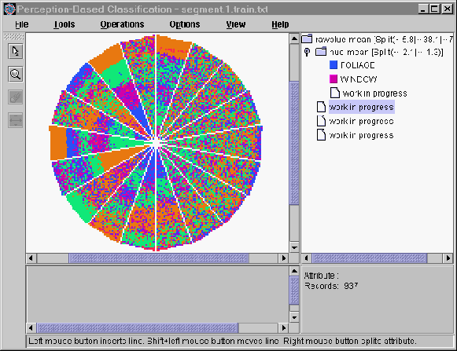
Interactive Visual Mining by Perception-Based Classification (PBC)
Data Interaction window
Knowledge Interaction window

Slide 49
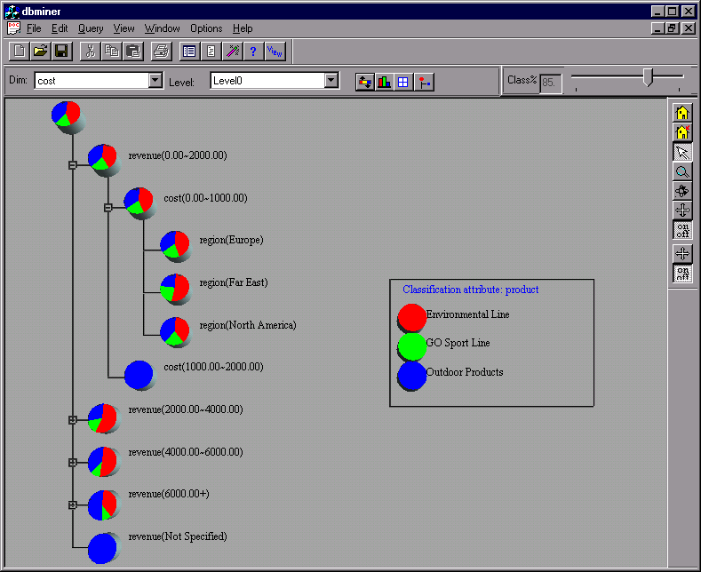
Presentation of Classification Results

Slide 50
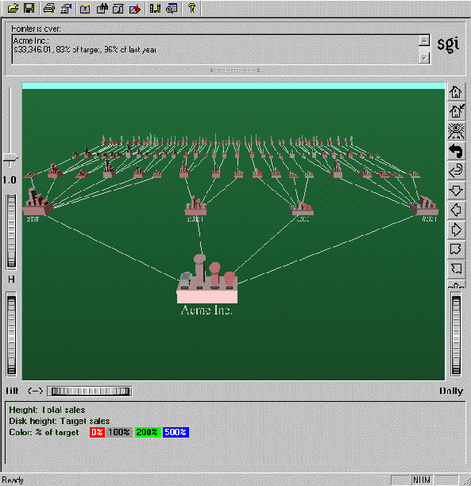
Visualization of a Decision Tree in SGI/MineSet 3.0

Slide 51
Chapter 8. Classification: Basic Concepts
Classification: Basic Concepts
Decision Tree Induction
Bayes Classification Methods
Rule-Based Classification
Model Evaluation and Selection
51
Notes:
51

Slide 52
Bayesian Classification
These are statistical classifiers.
Measures the probability that a given tuple belongs to a particular class.
Based Bayesian theorem.
A simple Bayesian classifier known as the naıve Bayesian classifier
Can be comparable with Decision tree and some neural network classifiers
Naıve Bayesian classifiers assume that the effect of an attribute value on a given class is independent of the values of the other attributes.
This assumption is called class conditional independence.
It is made to simplify the computations involved and, in this sense, is considered “naıve.

Slide 53
Bayes’ theorem
Let X be a data tuple.
In Bayesian terms, X is considered “evidence.”
Also measurements made on a set of n attributes.
Let H be some hypothesis such as that
“the data tuple X belongs to a specified class C”.
For classification problems, we want to determine P(H|X), the probability that the hypothesis H holds given the “evidence” X.
In other words, we are looking for the probability that tuple X belongs to class C.

Slide 54

Posterior and Prior Probability
P(H|X) is the posterior probability: (H conditioned on X)
Example If customers age>=35 and income >=40,000 then customer will buy a computer
Here H is depending on two attributes of X.
If customers buy computer we will know age and income of customer
P(H) is Prior Probability
Example Here customer will buy computer regardless of age and income constraints.
So H is Independent of X.
P(X|H) is also posterior probability: (X conditioned on H)
If we know age and income we know customer will buy computer.
P(X) is Prior Probability e.g: probability of customer x is of age 35 and earns 40000.
Bayesian Theorem

Slide 55
Bayesian Classification: Why?
A statistical classifier: performs probabilistic prediction, i.e., predicts class membership probabilities
Foundation: Based on Bayes’ Theorem.
Performance: A simple Bayesian classifier, naïve Bayesian classifier, has comparable performance with decision tree and selected neural network classifiers.
Incremental: Each training example can incrementally increase/decrease the probability that a hypothesis is correct — prior knowledge can be combined with observed data
Standard: Even when Bayesian methods are computationally intractable, they can provide a standard of optimal decision making against which other methods can be measured

Slide 56
Bayes’ Theorem: Basics
Total probability Theorem:
Bayes’ Theorem:
Let X be a data sample (“evidence”): class label is unknown
Let H be a hypothesis that X belongs to class C
Classification is to determine P(H|X), (i.e., posteriori probability): the probability that the hypothesis holds given the observed data sample X
P(H) (prior probability): the initial probability
E.g., X will buy computer, regardless of age, income, …
P(X): probability that sample data is observed
P(X|H) (likelihood): the probability of observing the sample X, given that the hypothesis holds
E.g., Given that X will buy computer, the prob. that X is 31..40, medium income

Slide 57
Prediction Based on Bayes’ Theorem
Given training data X, posteriori probability of a hypothesis H, P(H|X), follows the Bayes’ theorem
Informally, this can be viewed as
posteriori = likelihood x prior/evidence
Predicts X belongs to C_{i} iff the probability P(C_{i}|X) is the highest among all the P(C_{k}|X) for all the k classes
Practical difficulty: It requires initial knowledge of many probabilities, involving significant computational cost

Slide 58
Classification Is to Derive the Maximum Posteriori
Let D be a training set of tuples and their associated class labels, and each tuple is represented by an n-D attribute vector X = (x₁, x₂, …, x_{n})
Suppose there are m classes C₁, C₂, …, C_{m}.
Classification is to derive the maximum posteriori, i.e., the maximal P(C_{i}|X)
This can be derived from Bayes’ theorem
Since P(X) is constant for all classes, only
needs to be maximized

Slide 59
Naïve Bayes Classifier
A simplified assumption: attributes are conditionally independent (i.e., no dependence relation between attributes):
This greatly reduces the computation cost: Only counts the class distribution
If A_{k} is categorical, P(x_{k}|C_{i}) is the # of tuples in C_{i} having value x_{k} for A_{k} divided by |C_{i, D}| (# of tuples of C_{i} in D)
If A_{k} is continous-valued, P(x_{k}|C_{i}) is usually computed based on Gaussian distribution with a mean μ and standard deviation σ
and P(x_{k}|C_{i}) is

Slide 60
Naïve Bayes Classifier: Training Dataset
Class:
C1:buys_computer = ‘yes’
C2:buys_computer = ‘no’
Data to be classified:
X = (age <=30, Income = medium,
Student = yes, Credit_rating = Fair)

Slide 61
Naïve Bayes Classifier: An Example
P(C_{i}): P(buys_computer = “yes”) = 9/14 = 0.643
P(buys_computer = “no”) = 5/14= 0.357
Compute P(X|C_{i}) for each class
P(age = “<=30” | buys_computer = “yes”) = 2/9 = 0.222
P(age = “<= 30” | buys_computer = “no”) = 3/5 = 0.6
P(income = “medium” | buys_computer = “yes”) = 4/9 = 0.444
P(income = “medium” | buys_computer = “no”) = 2/5 = 0.4
P(student = “yes” | buys_computer = “yes) = 6/9 = 0.667
P(student = “yes” | buys_computer = “no”) = 1/5 = 0.2
P(credit_rating = “fair” | buys_computer = “yes”) = 6/9 = 0.667
P(credit_rating = “fair” | buys_computer = “no”) = 2/5 = 0.4
X = (age <= 30 , income = medium, student = yes, credit_rating = fair)
P(X|C_{i}) : P(X|buys_computer = “yes”) = 0.222 x 0.444 x 0.667 x 0.667 = 0.044
P(X|buys_computer = “no”) = 0.6 x 0.4 x 0.2 x 0.4 = 0.019
P(X|C_{i})*P(C_{i}) : P(X|buys_computer = “yes”) * P(buys_computer = “yes”) = 0.028
P(X|buys_computer = “no”) * P(buys_computer = “no”) = 0.007
Therefore, X belongs to class (“buys_computer = yes”)

Slide 62
Avoiding the Zero-Probability Problem
Naïve Bayesian prediction requires each conditional prob. be non-zero. Otherwise, the predicted prob. will be zero
Ex. Suppose a dataset with 1000 tuples, income=low (0), income= medium (990), and income = high (10)
Use Laplacian correction (or Laplacian estimator)
Adding 1 to each case
Prob(income = low) = 1/1003
Prob(income = medium) = 991/1003
Prob(income = high) = 11/1003
The “corrected” prob. estimates are close to their “uncorrected” counterparts
Without Laplacian Correction
Prob(income = low) = 0/1003 = ZERO ERROR
Prob(income = medium) = 990/1003
Prob(income = high) = 10/1003

Slide 63
Naïve Bayes Classifier: Comments
Advantages
Easy to implement
Good results obtained in most of the cases
Disadvantages
Assumption: class conditional independence, therefore loss of accuracy
Practically, dependencies exist among variables
E.g., hospitals: patients: Profile: age, family history, etc.
Symptoms: fever, cough etc., Disease: lung cancer, diabetes, etc.
Dependencies among these cannot be modeled by Naïve Bayes Classifier
How to deal with these dependencies? Bayesian Belief Networks

Slide 64
Lec #3

Slide 65
Chapter 8. Classification: Basic Concepts
Classification: Basic Concepts
Decision Tree Induction
Bayes Classification Methods
Rule-Based Classification
Model Evaluation and Selection
Project submission last date: 26/4/2017 (WED)
65
Notes:
65

Slide 66
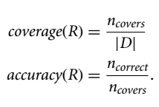
Using IF-THEN Rules for Classification
Rules are good way of representing information or bits of knowledge.
A rule based classifier uses a set of IF-THEN rules for classifications.
Represent the knowledge in the form of IF-THEN rules
R1: IF age = youth AND student = yes THEN buys_computer = yes
Rule antecedent/precondition vs. rule consequent
R1 can be written as
R1: (age=youth) /\ (student=yes) ➔ (buys_computer =yes))
If antecedent is satisfied for a given tuple then it covers the tuples.
Assessment of a rule: coverage and accuracy
n_{covers} = # of tuples covered by R
n_{correct} = # of tuples correctly classified by R
coverage(R) = n_{covers} /|D| /* D: training data set */
accuracy(R) = n_{correct} / n_{covers}

Slide 67
Example
R1: IF age = youth AND student = yes THEN buys_computer = yes
Consider rule R1, which covers 2 of the 14 tuples.
It can correctly classify both tuples.
Therefore,
coverage (R1) = 2 / 14 = 14.28% and
Accuracy (R1) = 2 / 2 = 100%

Slide 68
Rule trigger and fire
If a rule is satisfied by X tuple, the rule is said to be triggered.
If R1 is the only rule satisfied, then the rule fires by returning the class prediction for X.
Each trigger does not necessarily fire because there may be many rules satisfied
Problem
What if they each specify a different class? Or
what if no rule is satisfied by X?
If more than one rule are triggered, need conflict resolution
Size ordering: assign the highest priority to the triggering rules that has the “toughest” requirement (i.e., with the most attribute tests) i.e more no of attributes.
Class-based ordering: by decreasing order of class occurrence. Rules of frequent class come first. Rules of next prevalent class come next.
Rule-based ordering (decision list): rules are organized into one long priority list, according to some measure of rule quality(e.g accuracy and coverage) or by domain experts.

Slide 69
Rule Extraction from a Decision Tree
Rules are easier to understand than large trees
One rule is created for each path from the root to a leaf
Each attribute-value pair along a path forms a conjunction: the leaf holds the class prediction
Rules are mutually exclusive and exhaustive
Mutually exclusive: No two rules trigger for same tuple.
Exhaustive: No default value of rule, no order needed for rules, one rule of each attribute.
age?
<=30
31..40
>40
student?
yes
credit rating?
no
yes
excellent
fair
no
yes
no
yes
Example: Rule extraction from our buys_computer decision-tree
IF age = young AND student = no THEN buys_computer = no
IF age = young AND student = yes THEN buys_computer = yes
IF age = mid-age THEN buys_computer = yes
IF age = old AND credit_rating = excellent THEN buys_computer = no
IF age = old AND credit_rating = fair THEN buys_computer = yes

Slide 70
Rule Induction: Sequential Covering Method
Sequential covering algorithm: Extracts rules directly from training data
Typical sequential covering algorithms: FOIL, AQ, CN2, RIPPER
Rules are learned sequentially, each for a given class C_{i} will cover many tuples of C_{i} but none (or few) of the tuples of other classes
Steps:
Rules are learned one at a time
Each time a rule is learned, the tuples covered by the rules are removed
Repeat the process on the remaining tuples until termination condition, e.g., when no more training examples or when the quality of a rule returned is below a user-specified threshold
Notes:
First Order Inductive Learning (FOIL )
Comp. w. decision-tree induction: learning a set of rules simultaneously

Slide 71
Sequential Covering Algorithm
while (enough target tuples left)
generate a rule
remove positive target tuples satisfying this rule
Examples covered
by Rule 2
Examples covered
by Rule 1
Examples covered
by Rule 3
Positive examples

Slide 72
Rule Generation
To generate a rule
while(true)
find the best predicate p
if foil-gain(p) > threshold then add p to current rule
else break
A3=1
A3=1&&A1=2
A3=1&&A1=2
&&A8=5
Positive examples
Negative examples

Slide 73
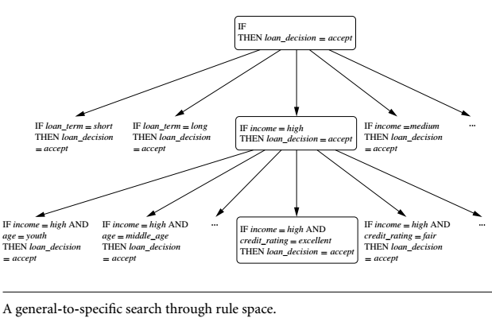
How to Learn-One-Rule?
Typically, rules are grown in a general-to-specific manner
We can think of this as a beam search, where we start off with an empty rule and then gradually keep appending attribute tests to it.
We append by adding the attribute test as a logical conjunct to the existing condition of the rule antecedent.

Slide 74
Rule Quality Measures
In ML Positive tuples are
The tuples of class for which we are learning rules
While remaining tuples are known as negative
Suppose R: IF condition THEN Class = c
While learning rule we ANDed it and our potential new rule is
R’: IF condition’ THEN Class = c
No we measure either R’ is any better than R.
Let Pos’(Neg’) are number of positive(negative) tuples of R’ So FOIL gain will be:
It favors rules that have high accuracy and cover many positive tuples.

Slide 75
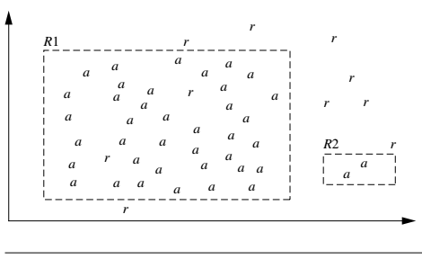
Choosing better Rules by Accuracy or coverage
Choosing a better rule can be based on
Accuracy or Coverage
In formation Gain proposed in First Order Inductive Learner (FOIL)
Example:
accuracy does not always bocme a better choice for better rule selection
Class Loan_decision = accepted, represented by a
Class Loan_decision = rejected, represented by r
Rule R1 covers 40 tuples and 38 are correctly classified, Accuracy is 95%
Rule R2 covers 2 tuples and all are correctly classified, accuracy is 100%.
Well R2 has greater accuracy but smaller coverage
While R1 has lesser accuracy but larger coverage
Which one is a better rule in this case?
R2 is better than R1 due to coverage.

Slide 76
How to Learn-One-Rule?
Rules are grown in a general-to-specific manner.
Start with the most general rule possible: condition = empty
Adding new attributes by adopting a greedy depth-first strategy
Picks the one that most improves the rule quality
Rule-Quality measures: consider both coverage and accuracy
Foil-gain (in FOIL & RIPPER): assesses info_gain by extending condition
favors rules that have high accuracy and cover many positive tuples
Rule pruning based on an independent set of test tuples
Pos/neg are # of positive/negative tuples covered by R.
If FOIL_Prune is higher for the pruned version of R, prune R
First Order Inductive Learning (FOIL )
Notes:
First Order Inductive Learner (FOIL)

Slide 77
Example…
Consider a training set that contains 100 positive examples and 400 negative examples. For each of the following candidate rules,
R1: A → + (covers 4 positive and 1 negative examples),
R2 : B → + (covers 30 positive and 10 negative examples),
R3 : C → + (covers 100 positive and 90 negative examples)
determine which is the best and worst candidate rule according to:
Accuracy
Coverage
FOIL Information Gain
Find which rule is over all the best.

Slide 78
Example…
Accuracy:
R1 = 4/5*100 = 80%
R2 = 30/40 *100 = 75%
R3 = 100/190 = 52.63%
Therefore R1 is the best candidate and R3 is the worst candidate according to rule accuracy.
Find Coverage
R1 = 5/500 =0.01
R2 = 0.08
R3 = 0.38
Therefore R3 is the best candidate and R1 is the worst candidate according to rule COVERAGE.
Notes:
Find Coverage
R1 = 5/500 = 0.01
R2 = 40/500 = 0.08
R3 = 190/500 = 0.38
R3 is the best and R1 is the worst

Slide 79
Example… (FOIL’s information gain)
pos = 100
neg = 400
R1
pos‘ = 4
neg‘ = 1
FOIL_Gain = 4(Log₂ (4/(4+1))-Log₂ (100/(100+400)) =
= 4(Log₂ (4/5)-Log₂ (1/5))
= 4(0.322 – (-2.322))
= 4*2
=8

Slide 80

Example…
R1: FOIL_GAIN = 8
R2: FOIL_GAIN
R3: FOIL_GAIN
Therefore, R3 is the best candidate and R1 is the worst candidate according to FOIL’s information gain.

Slide 81
Chapter 8. Classification: Basic Concepts
Classification: Basic Concepts
Decision Tree Induction
Bayes Classification Methods
Rule-Based Classification
Model Evaluation and Selection
81
Notes:
81

Slide 82
Model Evaluation and Selection
Evaluation metrics: How can we measure accuracy? Other metrics to consider?
Use validation test set of class-labeled tuples instead of training set when assessing accuracy
Methods for estimating a classifier’s accuracy:
Holdout method, random subsampling
Cross-validation
Bootstrap
Comparing classifiers:
Confidence intervals
Cost-benefit analysis and ROC Curves
82

Slide 83
Classifier Evaluation Metrics: Confusion Matrix
Confusion Matrix:
Actual class\Predicted class | C₁ | ¬ C₁
C₁ | True Positives (TP) | False Negatives (FN)
¬ C₁ | False Positives (FP) | True Negatives (TN)
Example of Confusion Matrix:
Actual class\Predicted class | buy_computer = yes | buy_computer = no | Total
buy_computer = yes | 6954 | 46 | 7000
buy_computer = no | 412 | 2588 | 3000
Total | 7366 | 2634 | 10000
Given m classes(m>=2), an entry, CM_{i,j} in a confusion matrix indicates # of tuples in class i (row) that were labeled by the classifier as class j (col.)
May have extra rows/columns to provide totals
83

Slide 84
Confusion Matrix
 |  | Predicted Class
 |  | Class= yes | Class= no
Actual Class | Class= yes | True Positive (TP) | False Negative (FN)
 | Class= no | False Positive (FP) | True Negative (TN)
TP: positive tuples, positively predicted (correctly predicted)
TN: negative tuples, negatively predicted (correctly predicted)
FP: negative tuples, positively predicted, (incorrect prediction)
FN: positive tuples, negatively predicted, (incorrect prediction)

Slide 85
Confusion Matrix…
P’ = Total (labelled as positive or predicted as positive)
N’ = Total (labelled as negative or predicted as negative)
 |  | Predicted Class
 |  | Class= yes | Class= no | TOTAL
Actual Class | Class= yes | True Positive (TP) | False Negative (FN) | P
 | Class= no | False Positive (FP) | True Negative (TN) | N
 | TOTAL | P’ | N’ | P+N
Total Actual Positive tuples
TP+FN
Total Actual Negative tuples
FP+FN
Total Predicted Positive tuples
TP+FP
Total Predicted Negative tuples
FN+TN
Total n umber of tuples

Slide 86
Confusion Matrix…
A/P | Class= yes | Class= no | TOTAL | Recognition (%)
Class= yes | True Positive (TP) | False Negative (FN) | P = TP + FN | TP Recog. = TP/P*100
Class= no | False Positive (FP) | True Negative (TN) | N = FP + TN | TN Recog. = TN/N*100
TOTAL | P’ = TP + FP | N’ = FN + TN | P+N | Overall Recog. = (TP+TN)/(P+N)
TP recognition rate is also known as SENSITIVITY = TP/P * 100
TN recognition rate is also known as SPECIFICITY = TN/N * 100
Overall recognition rate is also called ACCURACY = (TP+TN)/(P+N)
It reflects how well the classifier recognizes tuples of various classes.
Error Rate or misclassification rate = 1-accuracy = (FP+FN)/(P+N)

Slide 87
CW
A/P | Class= yes | Class= no | TOTAL | Recognition (%)
Class= yes | True Positive (TP) | False Negative (FN) | P = TP + FN | TP Recog. = TP/P*100
Class= no | False Positive (FP) | True Negative (TN) | N = FP + TN | TN Recog. = TN/N*100
TOTAL | P’ = TP + FP | N’ = FN + TN | P+N | Overall Recog. = (TP+TN)/(P+N)
A/C | Buy=y | Buy=n | Total | Recog. Rate
Buy=y | 6954 | 46 | ? | ?
Buy=n | 412 | 2588 | ? | ?
Total | ? | ? | ? | ?

Slide 88
Calculate Sensitivity, Specificity, Accuracy and Error.
A/C | Buy=y | Buy=n | Total
Buy=y | 6954 | 46 | 7000
Buy=n | 412 | 2588 | 3000
Total | 7366 | 2634 | 10000

Slide 89

Class imbalance problem
Suppose you trained a classifier on medical data to predict cancer
Say your accuracy rate of classifier for cancer=yes is 97%
If only 3% of overall tuples are representing cancer=yes
So this accuracy will not be acceptable. Because one class is rare.
Now we need to measure not only the accuracy but also other measures like sensitivity(how well correctly classified cancer=yes) and specificity(how well correctly classified cancer=no).
HW

Slide 90
Classifier Evaluation Metrics: Accuracy, Error Rate, Sensitivity and Specificity
A\P | C | ¬C
C | TP | FN | P
¬C | FP | TN | N
 | P’ | N’ | All
 | Predicted class
Actual class |  | Buy=y | Buy=n | Total
 | Buy=y | 6954 | 46 | 7000
 | Buy=n | 412 | 2588 | 3000
 | Total | 7366 | 2634 | 10000
Class Imbalance Problem:
One class may be rare, e.g. fraud, or HIV-positive
Significant majority of the negative class and minority of the positive class
Sensitivity: True Positive recognition rate
Sensitivity = TP/P
Specificity: True Negative recognition rate
Specificity = TN/N
Classifier Accuracy, or recognition rate: percentage of test set tuples that are correctly classified.
Accuracy = (TP + TN)/All
Error rate: 1 – accuracy, or
Error rate = (FP + FN)/All
90

Slide 91
Precision, Recall
A/P | Class= yes | Class= no | TOTAL | Recognition (%)
Class= yes | True Positive (TP) | False Negative (FN) | P = TP + FN | TP Recog. = TP/P*100 (SENSITIVITY)
Class= no | False Positive (FP) | True Negative (TN) | N = FP + TN | TN Recog. = TN/N*100 (SPECIFICITY)
TOTAL | P’ = TP + FP | N’ = FN + TN | P+N | Overall Recog. = (TP+TN)/(P+N) (ACCURACY)
 | Precision = TP/(TP+FP)
Recall = TP/P

Slide 92
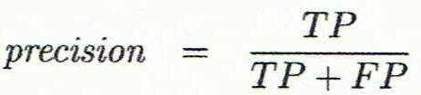
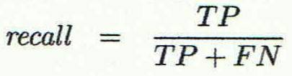
Classifier Evaluation Metrics: Precision and Recall, and F-measures
Precision: (exactness) – what % of tuples that the classifier labeled as positive are actually positive
Recall: (completeness) – what % of positive tuples did the classifier label as positive?
Perfect precision/recall score is 1.0
Inverse relationship between precision & recall
In previous example of medical classifier, cancer=yes
We may have high precision(all tuples have cancer are labelled correctly)
but very low recall (how many tuples are misclassified).
See example
92
Notes:
The precision perfect score is 1.0.
It tell us classier predicted all +ve tuples correctly
But it does not tell us how much –ve tuples are classified as +ve or vice versa. Called misclassification.

Slide 93
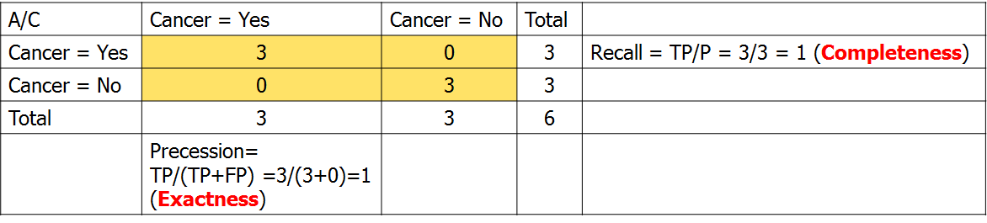
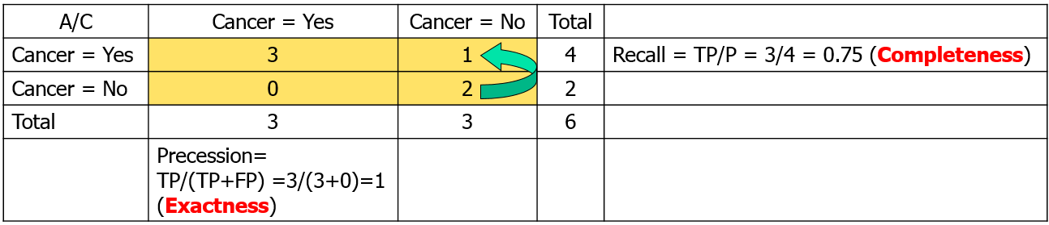
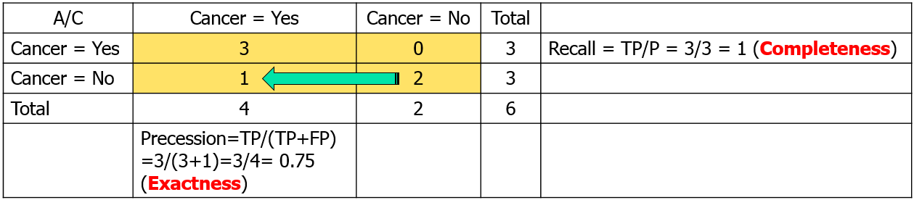
Example: Compare Precision and Recall
Notes:
The precision perfect score is 1.0.
It tell us classier predicted all +ve tuples correctly
But it does not tell us how much –ve tuples are classified as +ve or vice versa. Called misclassification.

Slide 94
F-measure (F-score)
Precision and recall scores are used together.
e.g in previous slide examples
1 precision have 1 recall value
1 precision have 0.75 recall value
0.75 precision have 1 recall value
On 1 precision we may have 1 or 0.75 recall values OR
On 1 recall we may have 1 or 0.75 precision values
An other way to combine them into a single measure called F-measure

Slide 95
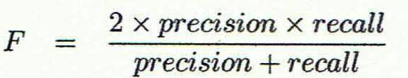
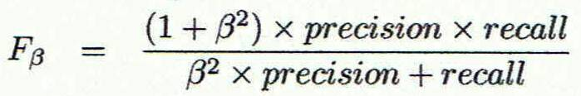
Classifier Evaluation Metrics: F-measures
F measure (F₁ or F-score): harmonic mean of precision and recall,
F_{ß}: weighted measure of precision and recall
assigns ß times as much weight to recall as to precision
95

Slide 96
Classifier Evaluation Metrics: Example
Actual Class\Predicted class | cancer = yes | cancer = no | Total | Recognition(%)
cancer = yes | 90 | 210 | 300 | 30.00 (sensitivity)
cancer = no | 140 | 9560 | 9700 | 98.56 (specificity)
Total | 230 | 9770 | 10000 | 96.40 (accuracy)
Precision = 90/230 = 39.13% Recall = 90/300 = 30.00%
96

Slide 97
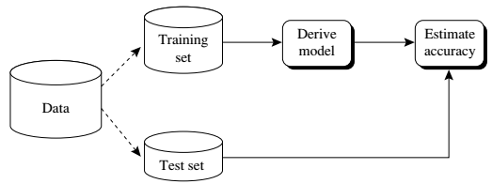
Evaluating Classifier Accuracy: Holdout & Cross-Validation Methods
Holdout method
Given data is randomly partitioned into two independent sets
Training set (e.g., 2/3) for model construction
Test set (e.g., 1/3) for accuracy estimation
Random sampling: a variation of holdout
Repeat holdout k times,
Overall accuracy = average of the accuracies obtained in k times.
97

Slide 98
Evaluating Classifier Accuracy: Holdout & Cross-Validation Methods…
Cross-validation (k-fold, where k = 10 is most popular)
Initially Randomly partition the data into k mutually exclusive subsets (D1,D2,D3…Dn), each approximately equal size
Training and testing is performed K times
At i-th iteration, use D_{i} as test set and others as training set, for Example
iteration#1: D1 is test set and D2,D3,….Dn are training sets
iteration#2: D2 is test set and D1,D3,….Dn are training sets
iteration#3: D3 is test set and D1,D2,D4,….Dn are training sets and so on….
Each set is used for both training and testing.
Leave-one-out: k folds where k = # of tuples, for small sized data
Only one fold remain out at a time for the test set.
*Stratified cross-validation*: folds are stratified so that class distribution in each fold is approximately the same as that in the initial data
98

Slide 99

Evaluating Classifier Accuracy: Bootstrap
Bootstrap
Works well with small data sets
Samples the given training tuples uniformly with replacement
i.e., each time a tuple is selected, it is equally likely to be selected again and re-added to the training set
Several bootstrap methods, and a common one is .632 boostrap
A data set with d tuples is sampled d times, with replacement, resulting in a training set of d samples. The data tuples that did not make it into the training set end up forming the test set. About 63.2% of the original data end up in the bootstrap, and the remaining 36.8% form the test set (since (1 – 1/d)^{d} ≈ e⁻¹ = 0.368)
Repeat the sampling procedure k times, overall accuracy of the model:
99

Slide 100
Comparing Classifiers Based on Cost–Benefit and ROC Curves
TP,TN,FP and FN can be used for assessing
Costs and benefits OR
Risk and Gains
Example1: In Medical Example of cancer prediction
Predicting cancer =yes as cancer=n (FN) is more costly than
Predicting cancer = no as cancer=y (FP)
Cost means: Danger and financial cost
Example2: Loan Prediction
Predicting loan=yes to defaulter is more costly than
Predicting loan=no to non-defaulter

Slide 101
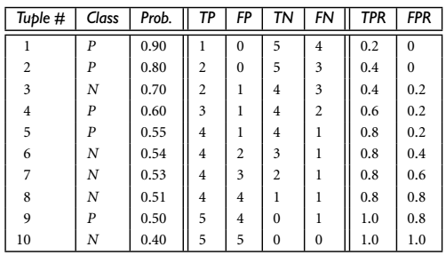
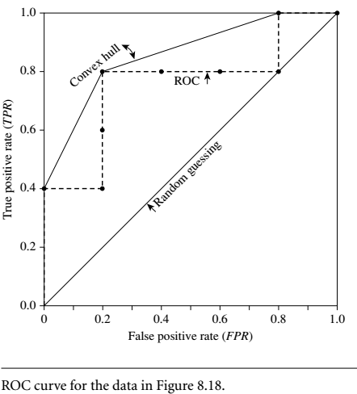
Receiver Operating Characteristics (ROC) Curve
TPR = sensitivity= TP/(TP+FN)
FPR = Specificity = TN/(TN+FP)

Slide 102
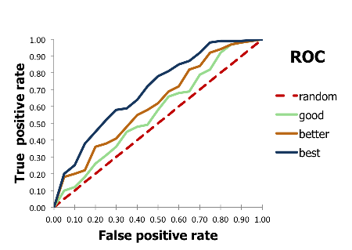
Example of ROC Curve

Slide 103
Model Selection: ROC Curves
ROC (Receiver Operating Characteristics) curves: for visual comparison of classification models
Originated from signal detection theory
Shows the trade-off between the true positive rate and the false positive rate
The area under the ROC curve is a measure of the accuracy of the model
Rank the test tuples in decreasing order: the one that is most likely to belong to the positive class appears at the top of the list
The closer to the diagonal line (i.e., the closer the area is to 0.5), the less accurate is the model
Vertical axis represents the true positive rate
Horizontal axis rep. the false positive rate
The plot also shows a diagonal line
A model with perfect accuracy will have an area of 1.0
103

Slide 104
For a two-class problem, an ROC curve allows us to visualize the trade-off between the rate at which the model can accurately recognize positive cases versus the rate at which it mistakenly identifies negative cases as positive for different portions of the test set.
Any increase in TPR(True Positive Rate) occurs at the cost of an increase in FPR(False Positive Rate).
The area under the ROC curve is a measure of the accuracy of the model.

Slide 105
Issues Affecting Model Selection
Accuracy
classifier accuracy: predicting class label
Speed
time to construct the model (training time)
time to use the model (classification/prediction time)
Robustness: handling noise and missing values
Scalability: efficiency in disk-resident databases
Interpretability
understanding and insight provided by the model
Other measures, e.g., goodness of rules, such as decision tree size or compactness of classification rules
105
Notes:
105

